Slide 1
Climate Data
Dave Eum
Ekamjit Deol
Jennifer Huynh
Omar Colmenares
Notes:
Speaker 1 (Dave):
Hi we are group 3, and our project is on climate change.
Here are my fellow team members….

Slide 2
Agenda
Introduction
Hypothesis
Cities and their significance
Data
Graphs
Notes:
Speaker 2 (Omar):
Here is the agenda for our presentation, we have tried to explain our methodology in a concise but holistic way.
First we will provide in an introduction on our project and why we decided it was one that is worth pursuing
Second we will go over our initial hypotheses for our presentation
Third we will go into the data we selected (cities and their significance) as well as the analysis performed on the data.
Lastly we will go over our results and explain the broader significance of our results, and opportunities for future projects

Slide 3


1. Intro
Our project is to uncover patterns of climate change in select cities and compare with patterns of global warming metrics
Notes:
Speaker 3 (Jennifer):
We were really curious with the ongoing climate change debate, particularly because of the recent election, and global unrest
Our project was to discover how evenly or unevenly climate change affects cities and communities around the world. We believe this is an important thing to evaluate, because it can give insight to the allocation of resources. E.g. If the arctic is affected to a greater degree than the tropics, is there a greater need for resources there?. As well as for guidance on allocating resources for protecting ecosystems around the world. Would it be better to spend resources in the southern hemisphere or the northern hemisphere, or the tropics or the arctic.

Slide 4
Objectives
Assess and compare metrics of global warming at a local and global scale
Access different data sources (API, conventional csv files) and integrate the information to provide the assessment on the similarities and differences with published data
Notes:
Speaker 1 (Dave): Our objective for this analysis was to assess and compare metrics of climate change in cities around the world to each other as well as to the high-level global warming trend.
We incorporated a variety of different data sources to have the most well-rounded, and complete project we could given our time line, and resources.

Slide 5
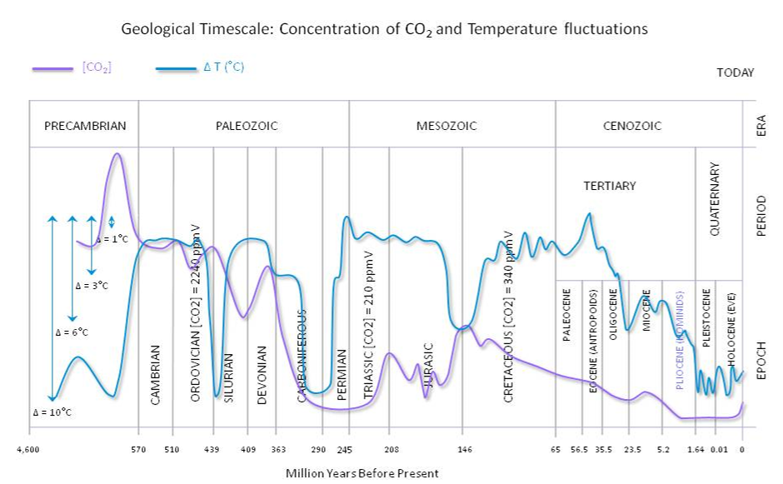
Some background about climate change and global warming:
Climate change is a complex problem and has been part of the evolution of our planet since we began our trip in the solar system 4.6 billion years ago
Climate changes as a result of changes in the planet and especially on the living organisms. The development of photosynthesis (generation of oxygen) and respiration (emission of CO2) have had a significant effect in our climate
Notes:
Speaker 2 Omar:
Climate change is a story that has been playing out since our planets origins nearly 4.6 billion years ago. In the past 150 years since the industrial revolution, there has been a realization that anthropogenic causes is leading to rapid climate change. This sudden change in climate, threatens ecosystems, and civilizations around the globe.

Slide 6
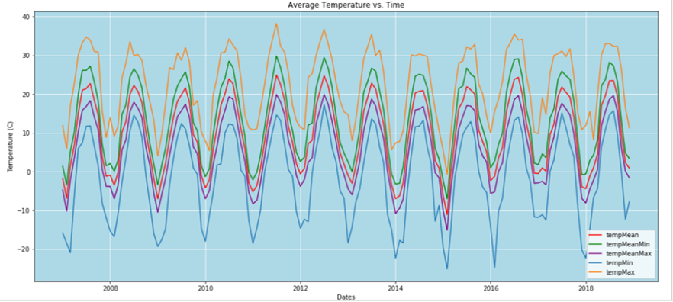
Our research question:
Take a look at the temperature data we pulled from Meteostat API for Toronto (https://api.meteostat.net/)
Can you tell if we follow the global pattern in a conclusive way?
Notes:
(Jennifer) Climate change is a long term trend that is observed over many decades, centuries and perhaps million of years. Anomalies can occur, take for example our recent snowstorm in the beginning of November.

Slide 7
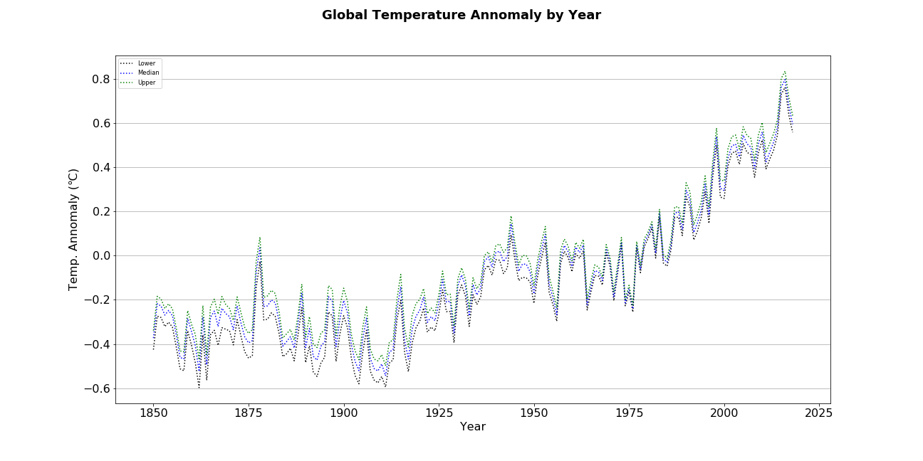
How to answer the research question:
Selected metric for global warming: We looked at the temperature anomalies of the past 11 years (2008 to the end of 2018) compared with the average temperature of a locality in the past 30 years (1970-2000). (https://ourworldindata.org/)
Notes:
Omar: As you can tell from the graph the global temperature anomaly from the baseline year of 1880 has been on an upward trend.
The metric we selected to analyze the temperature anomaly of a city was to find the change in the annual temperature of that city in each year from 2008 to 2018 inclusive, by finding the difference of the annual mean temperatures for years from 2008 to 2017 from the 30 year average of that city from the years 1970 - 2000. Any positive value means that current temperatures ar ehigher than they used to be

Slide 8
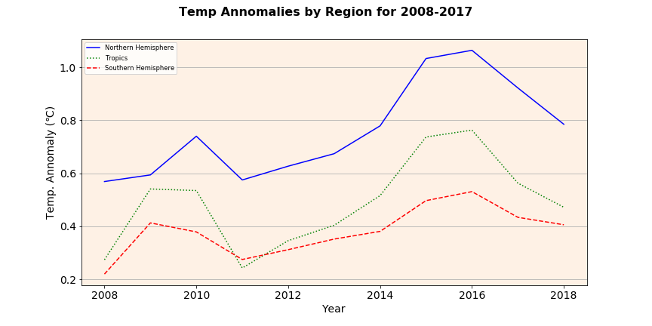
Cities and their significance
Temperature anomaly is higher in the northern hemisphere
Northern Hemisphere:
Toronto (Canada)
Murmansk (Russia)
Tropics:
Singapore
Southern Hemisphere:
Sydney
Notes:
(Omar)
Given our resources we chose to examine 4 cities in total.
The first two were from the northern hemisphere, with one from a relatively temperate environment (Toronto), and one from an arctic environment (Murmansk). The arctic climate is very different from the temperature climate so we felt it would be useful to incorporate that into our data.
From the tropics we chose to look at the city of singapore, because of the richness of data archives available.
Finally due to a lack of complete information in the antarctic we only examined one city in a temperate environment and that was the city of Sydney. Again, a major reason for choosing this city was the abundance of available data.

Slide 9
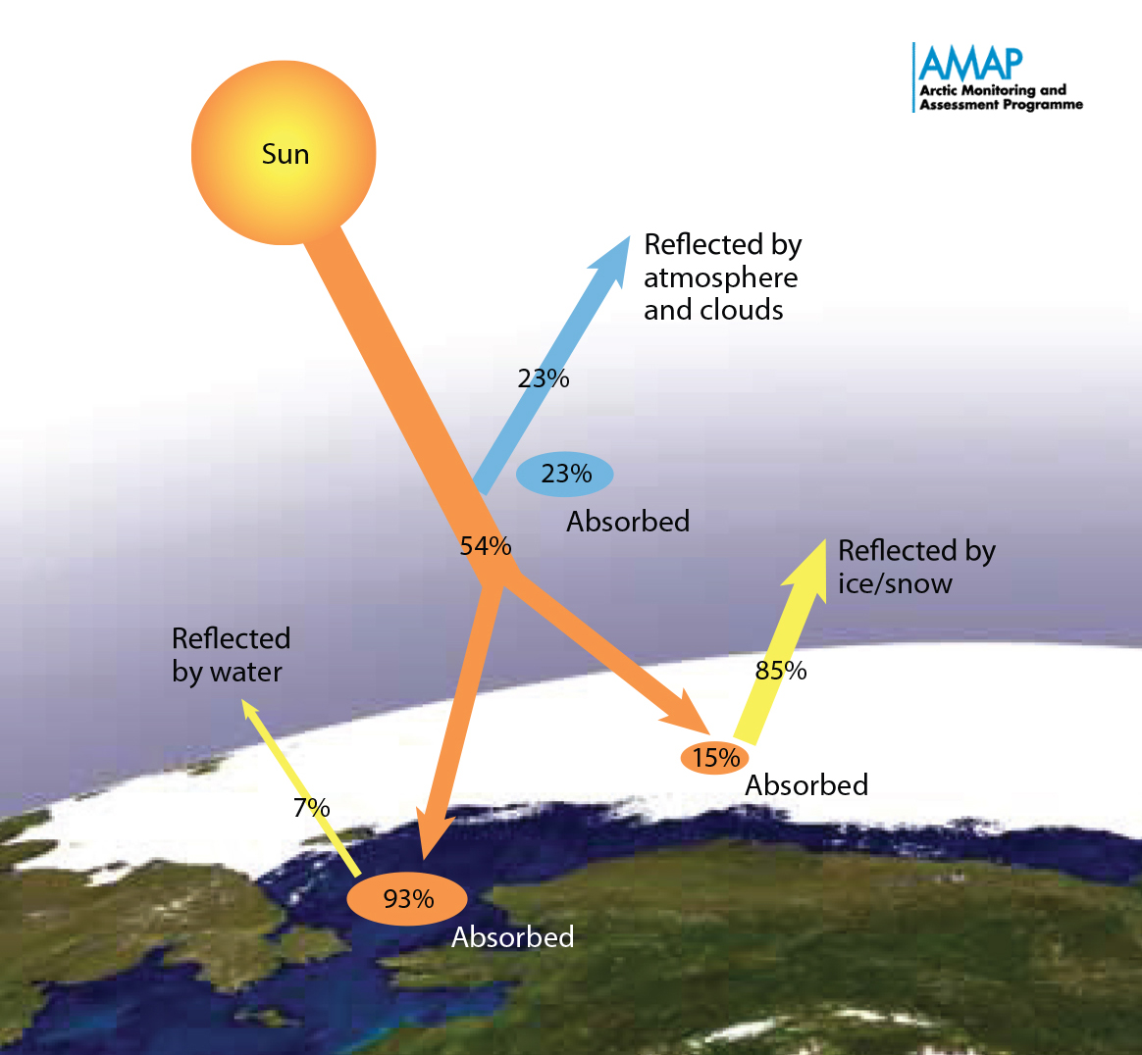
Hypothesis
We, initially predicted the Arctic will be the most affected climate change, because of the ice-albedo feedback effect, where by melting ice uncovers darker land which absorbs heat faster.
By that logic We believe the tropics would be the least affected.
Notes:
(Dave)http://enduringice.com/wp-content/uploads/2017/06/Arctic_albedo.jpg
Our initial hypothesis, was that the arctic region would be most strongly affected by climate change, because of the ice-albedo feedback efect.
As you are all no doubt aware, ice is incredibly reflective, ( you put your hands below your eyes in the winter and above in the summer). The reflection of sunlight reduces the temperature in the arctic.
When temperature warms, the amount of ice decreases, and in it plants darker soil and water, will absorb more light heating up the surrounding environment
(Explain figure)

Slide 10
Data and Methodology
Meteostat API (https://api.meteostat.net/): Mean temperature for the 4 localities for 2008 to 2018 (full year information)
Mean temperature for the last 30 years for each of the localities from a local weather station ⇒ Last 30 year average temperature for each location = Baseline
Temperature Anomaly = Annual Mean - Baseline
Notes:
(Jennifer)
We got our data from the Meteostat API, as well as local weather data station compiled in CSV s.
The data from meteostat only want as far back as 2008 so we relied on the weather station data to get a 30 year average of the temperature in a locality.
After that we calculated the anomaly by finding the difference between the annual mean from each year in 2008 to 2018 and the 30 year mean.

Slide 11
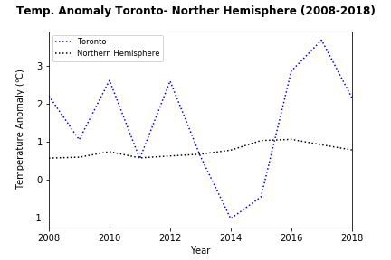
Graphs - Toronto
Temperature anomaly in Toronto shows more fluctuations and plots higher than the northern hemisphere values for most of the period 2008 to 2018 (we have been having some wild weather!)
Overall, the temperature anomaly is showing a warming trend compared to the mean temperature for the previous 30 years
Notes:
(Jennifer)You could say that for a colder city like Toronto, the temperature anomalies are shown changing every year. Our city is getting warmer and as a result we are experiencing more severe anomalies that are affecting our day to day lives. It is without a doubt by given the visual analysis there is a trend of warming temperature. Now that we have a visual confirmation….
Data cleanup - the CSV file for this was grouped into days, so I had to

Slide 12
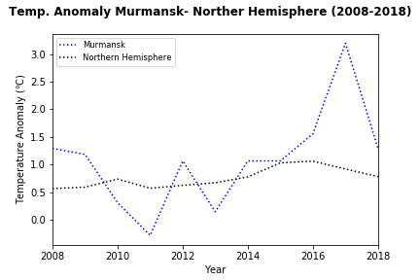
Graphs - Murmansk
Temperature anomaly in Murmansk is more comparable to the trends of the northern hemisphere temperature anomalies, except for the peak in 2016
The more similar or closer pattern might be related to the fact that Murmansk is a port city, so it is being subject to the oceans climate tempering effect
Coincidentally, both localities in the northern hemisphere show a significant peak and drop between 2016-2018, indicating that it is not a local event
Notes:
(Dave)

Slide 13
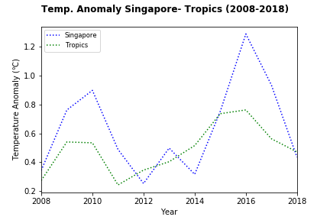
Graphs - Singapore
Temperature anomaly in Singapore is comparable to the trends of the tropics temperature anomalies, except for the peak in 2016
Coincidentally, the three localities in the northern hemisphere and tropics show a significant peak and drop between 2016-2018, indicating that it is not a local event (2016 was the hottest year on human record owing to a strong El Nino)
Notes:
(omar)

Slide 14
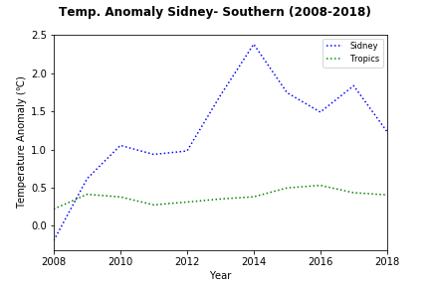
Graphs - Sydney
Temperature anomaly in Sidney shows high values than the southern temperature anomalies,
Unlike the localities in the northern and tropics zones, the peak of the anomaly started in 2014 and there is still a minor peak and drop between 2016-2018 as in the other zones.
Notes:
(Dave)

Slide 15
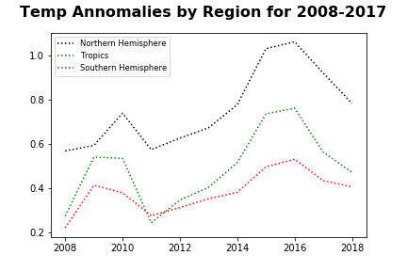
Future Changes
Southern Hemisphere:
Sydney
We need to pick a parallel to Murmansk in the Southern Hemisphere however, there is very little data available from antartica.
Also, Sydney has more temperate weather (33ºS latitude) than Toronto (42ºN)
Notes:
(Jennifer)
In hindsight Sydney was a bad decision, because it doesn't snow in sydney whereas it does in both Toronto and Murmansk.
A new city would need be to selected to analyze data, however there simply are not cities with enough data in regions that snow heavily in the southern hemisphere.

Slide 16
Conclusions
Data from different data sources were integrated and there is a preliminary assessment on global warming at each of the localities
Temperature anomalies in Singapore and Murmansk are comparable to temperature anomalies for the northern and tropical areas
Two of the northern and southern hemispheres seem to show higher values of temperature anomalies. Both are relatively large cities and population and economic activities might be causing some of the high temperature anomalies values compared to overall regional temperature anomalies
These results are preliminary and needs to be assessed based on data that have been QC’ed and perhaps more local data (temperature anomaly for each of the countries/provinces rather than the overall geographical region used in this project
Notes:
(Dave)

Slide 17
References
http://enduringice.com/wp-content/uploads/2017/06/Arctic_albedo.jpg -- [slide 9]
http://www.biocab.org/carbon_dioxide_geological_timescale.html - [slide 5]
https://api.meteostat.net/) – data for API

